Slide 1
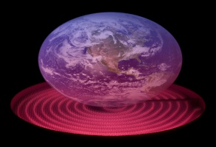
Vision
Higher Christianity Belief Rates
Greater Biodiversity
Enhanced Education
Vision for my Society
Vision for myself
Listener
Optimism
Leader

